Slide 1
Preliminary design and implementation
Group 1: Volvo Co-Pilot eco-driving

Slide 2
Introduction to Client & Project
Volvo Construction Equipment & Volvo Co-Pilot
Notes:
Brief introduction to your client and the product to be developed

Slide 3

Client

Slide 4
Objectives
Implement an Android application for Volvo’s CoPilot tablet.
Receive parameters such as speed, fuel consumption, distance, etc.
Create a score from the input parameters.
Present the data to the driver in an intuitive manner.
Upload the score to an online scoreboard (Web Portal).

Slide 5

End Goal
Encourage engagement with eco-driving principles.

Slide 6
Changes, events, reactions
…requirements, surprises, feedback
Notes:
Describe any important events in the project since the previous presentation, especially if there have been any changes or surprises. For example: Have you modified your understanding of the problem, have you re-formulated/deleted/added requirements? If you have presented mock-ups or early prototypes, describe the client’s feedback.

Slide 7
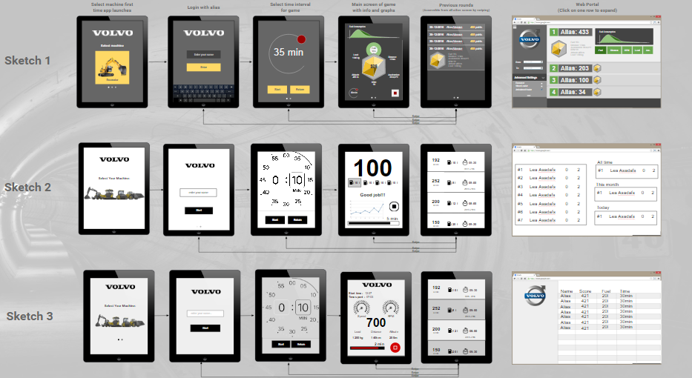
Client Reaction

Slide 8
High-level design
Choices & Motivations
Notes:
Present the main design decisions and the resulting high-level/architectural design. Use pictures and notation to aid the description, but avoid showing too much details. Think about what is interesting and understandable for the audience. Motivate the design decisions. How have the requirements affected your design choices?

Slide 9
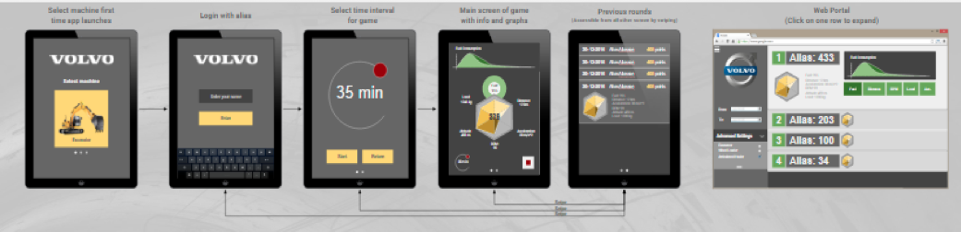
Overlook
System is divided to two parts: Android application and web application.

Slide 10
Detailed design
Areas of Interest
Notes:
Present some selected parts of your detailed design. Select representative or particularly interesting examples. Showing e.g., class and sequence diagrams can be a good idea, but think carefully about what information to focus on, and how much the audience can understand in a short time.

Slide 11
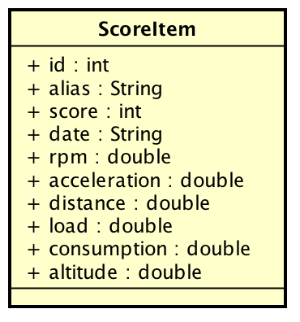
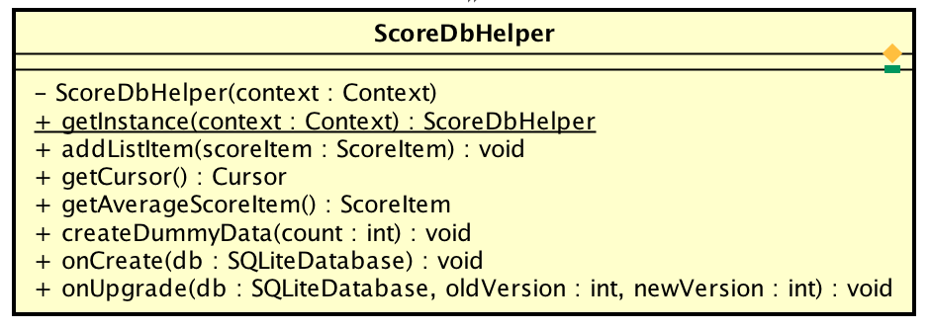
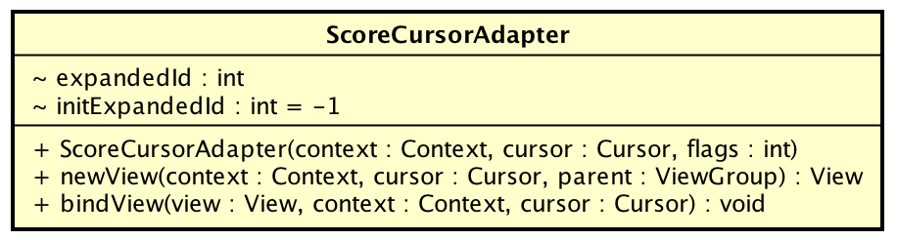
Android app: High-score list
SQLite Database
Id | alias | score | fuel consumption | acceleration | speed | load | rpm | date
ScoreDbHelper – Access to database
ScoreCursorAdapter – Connecting database to UI
ScoreItem – data structure

Slide 12
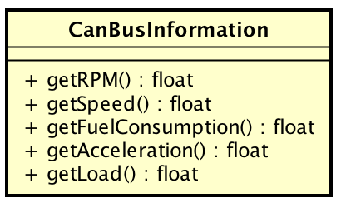
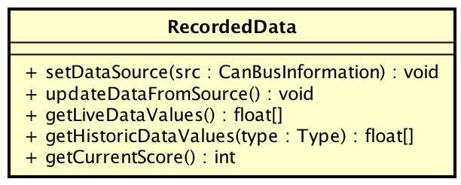
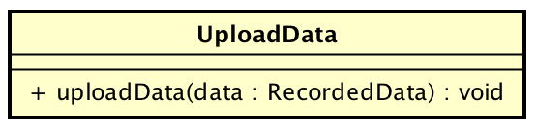
Android app: Game screen
CanBusInformation – Get raw data from CAN
DataRecorder – keep track of historical data and calculate score, etc.
UploadData – upload data to web portal
Gamification – Interactive responses

Slide 13
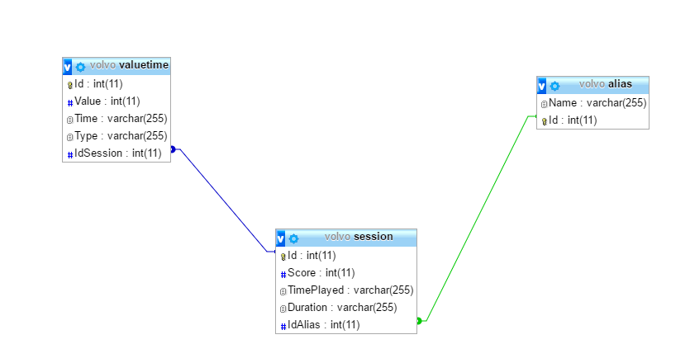
Web Portal: API
push_session
get_data

Slide 14
Implementation
Demo
Notes:
At this point, you should also have implemented something that can be presented. How much you have will differ from project to project, but something should be shown. It can be in form of screenshots, a video or a live demo. If you show a live demo, please rehearse and prepare what you will show – there will not be time to present every little nice detail you are proud of! Also, prepare a backup solution (screenshots, movie) in case something goes wrong.

Slide 15
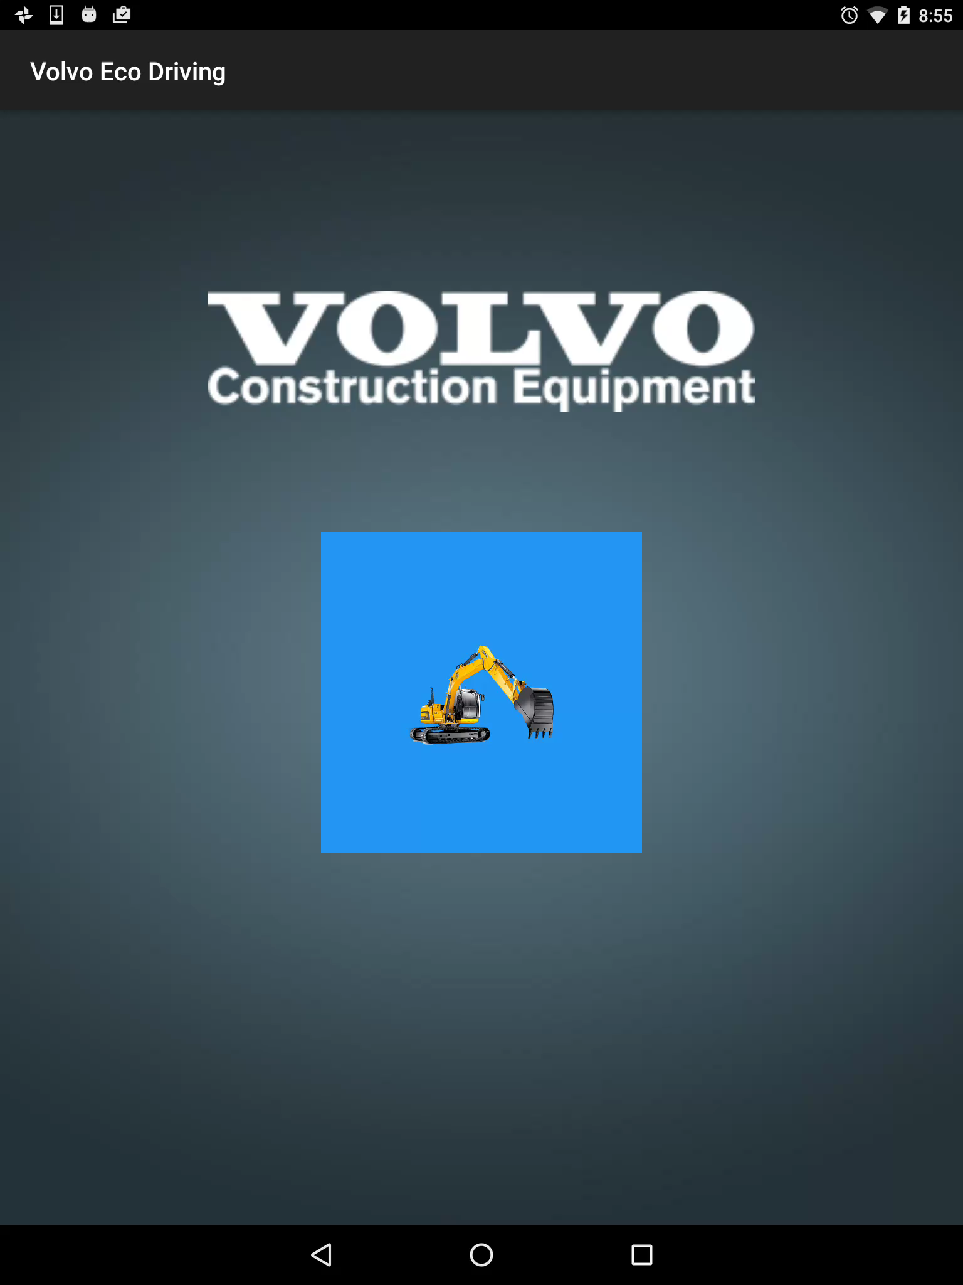

Slide 16
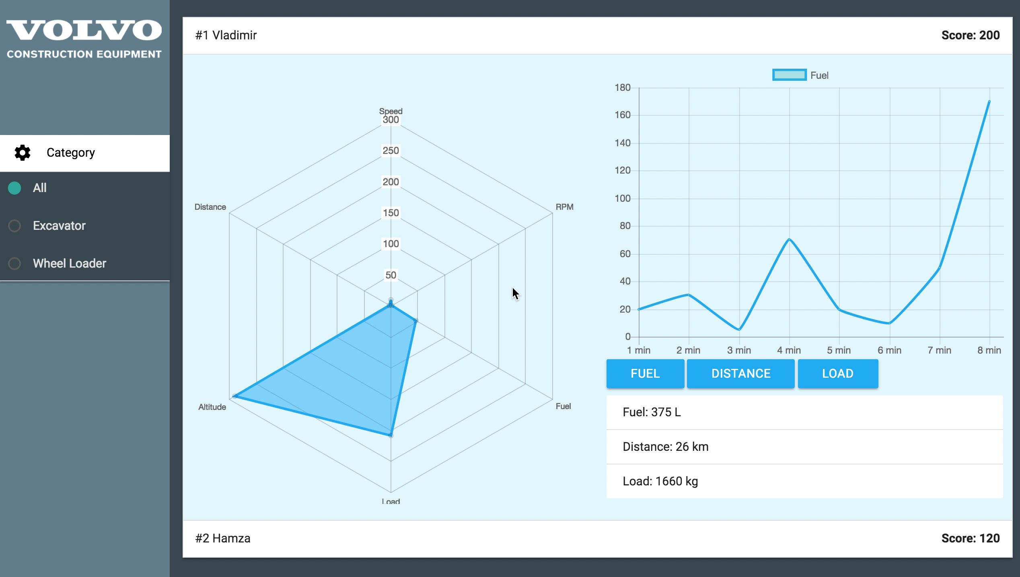

Slide 17
Further progress
The future, life, the universe and everything
Notes:
Give a short note on how you intend to spend the remaining time of your project. For example, what are the main features that remains to be implemented, how/when will you perform testing, how/when will you involve the users, etc.

Slide 18
Further progress
Upload data from App to Web Portal
Save local scores in App
Create a swiping navigation in the App
Styling and layout in Co-Pilot
Test App with simulators
Improve notifications
Insure consistency in activity lifecycle

Slide 19
Anything else the audience might find interesting
…some jokes, Albert Camus and Schrodinger's Cat
Notes:
Anything else that should be interesting for the other groups to hear!

